Slide 1

Enhancing Mobile Forensic Investigations with Blockchain Technology
Presenter Name:
DAMULURI UDAYKIRAN
2023005711
Guide Name:
Dr. Satya brata Das
CSE, GST, Visakhapatnam

Slide 2
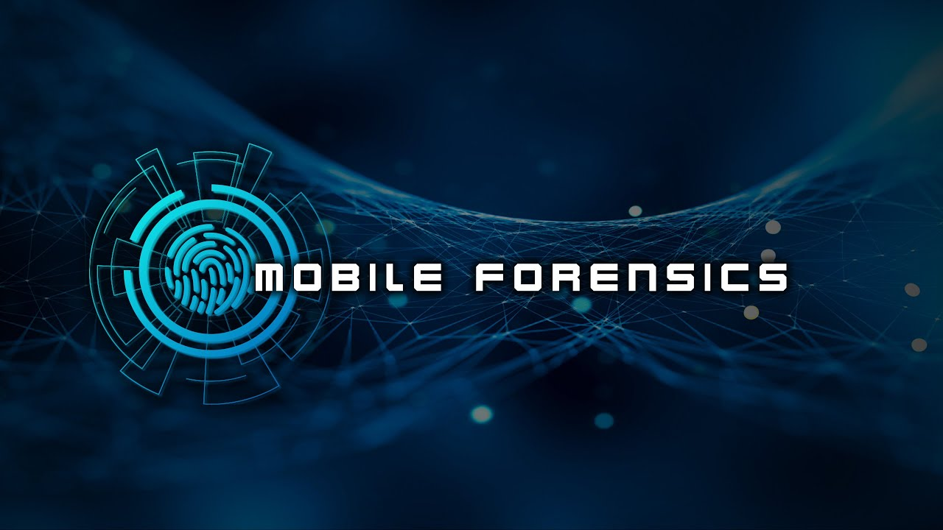
Contents
1. Abstract
2. Introduction
3. Literature Review
4. Requirement Analysis
5. Methodology/ Tools/Methods to be used
6. Conclusion
7. References
CSE, GST, Visakhapatnam

Slide 3
Abstract
Mobile devices have become important sources of evidence in forensic investigations, accounting for more than 90% of all crimes in the digital age. Traditional mobile forensics, on the other hand, has serious concerns with data integrity, manipulation, and maintaining a safe chain of custody. This project proposes combining blockchain technology with mobile forensics to increase the dependability and security of electronic evidence. The decentralized and immutable ledger of blockchain allows for safe recording and tracking of forensic data, ensuring tamper-proof evidence throughout the investigation. The study shows how blockchain-based mobile forensics may overcome traditional limitations by improving the integrity, security, and transparency of mobile forensic investigations. Finally, this innovative method may increase law enforcement's ability to investigate and punish mobile crimes.
CSE, GST, Visakhapatnam

Slide 4
Introduction
Blockchain technology, with its decentralized, immutable, and transparent design, offers a promising solution to these issues. By introducing blockchain into mobile forensic processes, evidence can be recorded in a tamper-resistant and verifiable manner, ensuring that any alterations or unauthorized access are detectable. Blockchain's ability to create immutable audit trails, secure the chain of custody, and enhance the integrity of evidence handling can strengthen the overall credibility of forensic findings.The integration of blockchain technology into mobile forensics to address the limitations of conventional methods. By leveraging blockchain’s unique properties, this research aims to propose a framework that ensures data integrity, enhances collaboration, and safeguards the credibility of mobile forensic investigations in the digital age.
CSE, GST, Visakhapatnam

Slide 5
LITERATURE REVIEW​
Year | Title | Aim | Method | Gap
2022(Wang, Z., Li, X., & Liu, J.) | Blockchain-Enabled Secure Evidence Management in Mobile Forensics | To design a blockchain-based system that ensures secure management of digital evidence in mobile forensic investigations. | The paper proposes a permissioned blockchain for managing digital evidence to ensure its immutability and integrity. The methodology involves implementing a consensus algorithm to validate each transaction related to evidence acquisition and storage. | Additionally, more focus is needed on privacy issues, such as how sensitive mobile data can be encrypted or anonymized when stored on the blockchain.
CSE, GST, Visakhapatnam​

Slide 6
LITERATURE REVIEW​
Year | Title | Aim | Method | Gap
2023(Sharma, P., & Patel, M.) | Blockchain-Based Digital Chain of Custody for Mobile Forensic Investigations | To implement a blockchain-based digital chain of custody (CoC) that ensures the integrity and accountability of evidence collected in mobile forensic cases. | This paper presents a prototype where each piece of digital evidence is hashed using SHA-256, and the hash is stored on an Ethereum blockchain. The focus is on the traceability and tamper-resistance of evidence. | While the solution effectively addresses the need for transparency and auditability, it is not well-suited for handling large datasets due to blockchain's storage limitations.
CSE, GST, Visakhapatnam​

Slide 7
LITERATURE REVIEW​
Year | Title | Aim | Method | Gap
2024 (Zhang, L., & Kumar, P. ) | Blockchain-Driven Chain of Custody for Mobile Device Evidence: A Performance Analysis | To assess the performance of blockchain systems in maintaining an immutable chain of custody for mobile device forensic evidence. | The authors created a Quorum-based blockchain system for managing the chain of custody in forensic investigations. They compared its performance to standard forensic databases and investigated layer-2 scaling strategies, such as sidechains, for effectively handling massive amounts of forensic data. | The study shows that blockchain improves performance, but it does not address cross-jurisdictional legal difficulties in evidence management, particularly when various law enforcement agencies from different areas want access. The study also raises the topic of how to manage data privacy in a distributed ledger system.
CSE, GST, Visakhapatnam​

Slide 8
LITERATURE REVIEW​
Year | Title | Aim | Method | Gap
2024 (Ahmed, A., & Rehman, M. ) | Integrating Blockchain with Mobile Forensics | To investigate how blockchain can enhance the data integrity of mobile forensic investigations in cybercrime cases by eliminating potential tampering with evidence. | The authors conducted a case study by applying Hyperledger Fabric to simulate a mobile forensic investigation. The evidence collected from mobile devices was hashed and stored on the blockchain while all forensic actions were logged as transactions. The study utilized a Proof of Authority (PoA) | The research successfully demonstrates how blockchain improves integrity, but the lack of focus on real-time forensic analysis poses a challenge. Furthermore, the study doesn't fully address the performance bottleneck that may arise when handling complex forensic tools in parallel with blockchain transactions.
CSE, GST, Visakhapatnam​

Slide 9
Requirement Analysis​
Software:
Hardware:
Ethereum (private network) for decentralized application.
Cellebrite UFED, Magnet AXIOM, for mobile data extraction.
SHA-256 or SHA-512 hashing algorithms Docker for containerizing blockchain nodes.
Decentralized storage systems
Server with minimum 8 GB RAM
High-performance storage (SSD)
Mobile device connectors
High-capacity storage systems (RAID or NAS)
CSE, GST, Visakhapatnam

Slide 10
System Architecture
COLLECTION
↓
ANALYSIS
↓
DOCUMENTATION
↓
PRESENTATION
CSE, GST, Visakhapatnam

Slide 11
Methodology
1 Evidence Collection :
This phase involves the identification, seizure, and extraction of digital evidence from mobile devices.
Steps:
1 Seizure of Mobile Device: Secure the mobile device in a manner that prevents tampering (e.g., placing the device in a Faraday bag).
2. Data Acquisition: Extract data from the mobile device using mobile forensic tools .
Types of Data Collected:
Communication logs (calls, SMS, emails)
App data (social media, encrypted chats)
Files and media
Metadata (timestamps, location data)
CSE, GST, Visakhapatnam

Slide 12
2 Evidence Analysis
This phase involves the analysis of the extracted mobile device data to uncover relevant evidence.
Steps:
1. Forensic Analysis Tools:
Examine communication records, application data, and recover deleted files.
2. Cross-verification:
During analysis, the hash of each analyzed data point is compared to the corresponding hash stored on the blockchain.
3. Chain of Custody:
Any access to or analysis of the evidence is recorded on the blockchain to ensure a traceable chain of custody.
CSE, GST, Visakhapatnam

Slide 13
3 Reporting and Presentation
The final phase involves generating reports and presenting the findings in a legal or investigative context, with blockchain proving the authenticity of the evidence.
Steps:
1 Forensic Report Generation:
Produce a comprehensive report detailing the evidence, forensic methods, analysis results, and blockchain logs showing the chain of custody.
2 Blockchain-Based Proof:
Include blockchain transaction IDs or logs showing how the evidence was handled. Use these logs to prove that the evidence presented in court is exactly what was collected from the mobile device.
CSE, GST, Visakhapatnam

Slide 14
Conclusion
Mobile forensic investigations are critical in uncovering digital evidence that can support criminal cases and ensure justice. However, traditional forensic methods face challenges in ensuring the integrity, security, and transparency of evidence, which can compromise the credibility of the investigative process. This project has demonstrated that blockchain technology—known for its decentralized, immutable, and tamper-resistant properties—holds great potential to address these challenges in mobile forensics.
CSE, GST, Visakhapatnam

Slide 15
References
Kher, R., & Kim, Y. (2023). "Blockchain-Based Solutions for Evidence Management in Digital Forensics." IEEE Access, 11, 87945-87956. This study explores blockchain's applications in digital forensics, focusing on its potential to provide tamper-proof records and improve chain-of-custody documentation.
Raza, S., & Jamal, S. (2022). "Securing Mobile Device Forensics Using Blockchain." Journal of Digital Forensics, Security, and Law, 17(2), 35-47. This paper discusses blockchain’s role in securing forensic workflows in mobile device investigations, addressing unique challenges related to mobile data integrity.
Kumar, V., & Singh, R. (2022). "An Evaluation of Blockchain for Evidence Authentication in Forensic Investigations." Forensic Science International: Reports, 4, 100193. The authors assess blockchain’s effectiveness in maintaining evidence authenticity and examine blockchain integration in mobile forensic workflows.
CSE, GST, Visakhapatnam

